Slide 1
TOPIC 6 FUNCTION

Slide 2
CONTENTS
Define new functions in Python
Function calls and parameter passing in Python
Functions to reduce code duplication and increase program modularity

Slide 3
Define new functions in Python
A function is a group of statements that exist within a program for the purpose of performing a specific task.
Getting the employee’s hourly pay rate
Getting the number of hours worked
Calculating the employee’s gross pay
Calculating overtime pay
Calculating withholdings for taxes and benefits
Calculating the net pay
Printing the paycheck

Slide 4
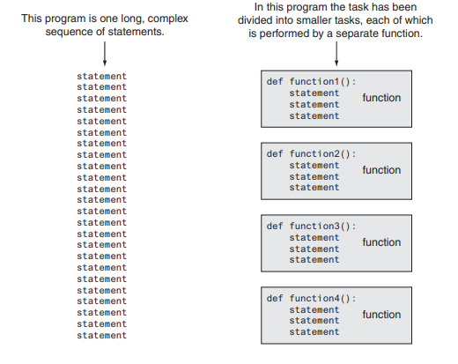
A function that gets the employee’s hourly pay rate
A function that gets the number of hours worked
A function that calculates the employee’s gross pay
A function that calculates the overtime pay
A function that calculates the withholdings for taxes and
benefits
A function that calculates the net pay
A function that prints the paycheck

Slide 5
Function calls and parameter passing in
Python
The code for a function is known as a function definition. To execute the function, you write a statement that calls it.
Defining and Calling a Function
To create a function, you write its definition. Here is the general format of a function definition in Python:
def function_name():
statement
statement
etc.

Slide 6
def message():
print('I am Arthur,')
print('King of the Britons.')
1 # This program demonstrates a function.
2 # First, we define a function named message.
3 def message():
4 print('I am Arthur,')
5 print('King of the Britons.')
6
7 # Call the message function.
8 message()
Program Output
I am Arthur,
King of the Britons.

Slide 7
1 # This program has two functions. First we
2 # define the main function.
3 def main():
4 print('I have a message for you.')
5 message()
6 print('Goodbye!')
7
8 # Next we define the message function.
9 def message():
10 print('I am Arthur,')
11 print('King of the Britons.')
12
13 # Call the main function.
14 main()
Program Output
I have a message for you.
I am Arthur,
King of the Britons.
Goodbye!

Slide 8
1 # This program displays step-by-step instructions
2 # for disassembling an Acme dryer.
3 # The main function performs the program's main logic.
4 def main():
5 # Display the start-up message.
6 startup_message()
7 input('Press Enter to see Step 1.')
8 # Display step 1.
9 step1()
10 input('Press Enter to see Step 2.')
11 # Display step 2.
12 step2()
13 input('Press Enter to see Step 3.')
14 # Display step 3.
15 step3()
16 input('Press Enter to see Step 4.')
17 # Display step 4.
18 step4()
19
20 # The startup_message function displays the
21 # program's initial message on the screen.
22 def startup_message():
23 print('This program tells you how to')
24 print('disassemble an ACME laundry dryer.')
25 print('There are 4 steps in the process.')
26 print()
27
28 # The step1 function displays the instructions
29 # for step 1.
30 def step1():
31 print('Step 1: Unplug the dryer and')
32 print('move it away from the wall.')
33 print()
34
35 # The step2 function displays the instructions
36 # for step 2.
37 def step2():
38 print('Step 2: Remove the six screws')
39 print('from the back of the dryer.')
40 print()
41
42 # The step3 function displays the instructions
43 # for step 3.
44 def step3():
45 print('Step 3: Remove the back panel')
46 print('from the dryer.')
47 print()
48
49 # The step4 function displays the instructions
50 # for step 4.
51 def step4():
52 print('Step 4: Pull the top of the')
53 print('dryer straight up.')
54
55 # Call the main function to begin the program.
56 main()

Slide 9
Program Output
This program tells you how to
disassemble an ACME laundry dryer.
There are 4 steps in the process.
Press Enter to see Step
Step 1: Unplug the dryer and move it away from the wall.
Press Enter to see Step 2.
Step 2: Remove the six screws from the back of the dryer.
Press Enter to see Step 3.
Step 3: Remove the back panel from the dryer.
Press Enter to see Step 4.
Step 4: Pull the top of the dryer straight up.

Slide 10
1 # This program demonstrates two functions that
2 # have local variables with the same name.
3
4 def main():
5 # Call the texas function.
6 texas()
7 # Call the california function.
8 california()
9
10 # Definition of the texas function. It creates
11 # a local variable named birds.
12 def texas():
13 birds = 5000
14 print(f'texas has {birds} birds.')
15
16 # Definition of the california function. It also
17 # creates a local variable named birds.
18 def california():
19 birds = 8000
20 print(f'california has {birds} birds.')
21
22 # Call the main function.
23 main()
Program Output :
texas has 5000 birds.
california has 8000 birds.

Slide 11
1 # This program demonstrates an argument being
2 # passed to a function.
3
4 def main():
5 value = 5
6 show_double(value)
7
8 # The show_double function accepts an argument
9 # and displays double its value.
10 def show_double(number):
11 result = number * 2
12 print(result)
13
14 # Call the main function.
15 main()
Program Output
10

Slide 12
1 # This program converts cups to fluid ounces.
2
3 def main():
4 # display the intro screen.
5 intro()
6 # Get the number of cups.
7 cups_needed = int(input('Enter the number of cups: '))
8 # Convert the cups to ounces.
9 cups_to_ounces(cups_needed)
10
11 # The intro function displays an introductory screen.
12 def intro():
13 print('This program converts measurements')
14 print('in cups to fluid ounces. For your')
15 print('reference the formula is:')
16 print(' 1 cup = 8 fluid ounces')
17 print()
18
19 # The cups_to_ounces function accepts a number of
20 # cups and displays the equivalent number of ounces.
21 def cups_to_ounces(cups):
22 ounces = cups * 8
23 print(f'That converts to {ounces} ounces.')
24
25 # Call the main function.
26 main()
Program Output
This program converts measurements
in cups to fluid ounces. For your
reference the formula is:
1 cup = 8 fluid ounces
Enter the number of cups: 4
That converts to 32 ounces.

Slide 13
1 # This program displays five random
2 # numbers in the range of 1 through 100.
3 import random
4
5 def main():
6 for count in range(5):
7 print(random.randint(1, 100))
8
9 # Call the main function.
10 main()
Program Output
89
7
16
41
12

Slide 14
Writing Your Own Value-Returning Functions
A value-returning function has a return statement that returns a value back to the part of the program that called it.
def function_name():
statement
statement
etc.
return expression
return expression
The value of the expression that follows the keyword return will be sent back to the part of the program that called the function. This can be any value, variable, or expression that
has a value (such as a math expression).

Slide 15
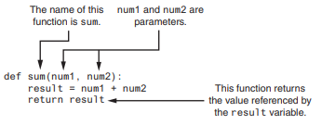
def sum(num1, num2):
result = num 1 + num 2
return result

Slide 16
# This program uses the return value of a function.
3 def main():
4 # Get the user's age.
5 first_age = int(input('Enter your age: '))
7 # Get the user's best friend's age.
8 second_age = int(input("Enter your best friend's age: "))
10 # Get the sum of both ages.
11 total = sum(first_age, second_age)
13 # Display the total age.
14 print(f'Together you are {total} years old.')
16 # The sum function accepts two numeric arguments and
17 # returns the sum of those arguments.
18 def sum(num1, num2):
19 result = num1 + num2
20 return result
22 # Call the main function.
23 main()
Program Output
Enter your age: 22
Enter your best friend's age: 24
Together you are 46 years old.

